Slide 1
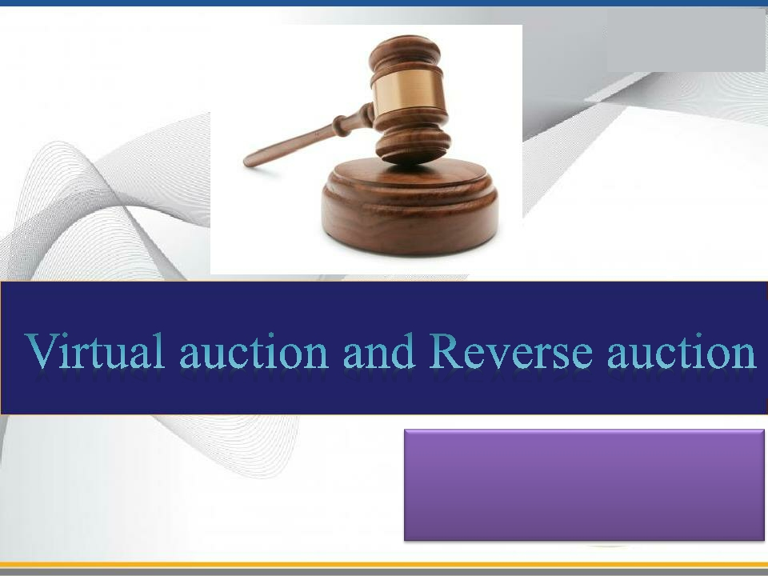




Name: Ujjwal Maity
Roll: 16800116008

Slide 2

What is an auction?
• Auction is an process of buying and selling goods or services
by offering them up for bid, taking bids, and then selling the
item to the highest bidder.
• Its a billion dollar industry and emerging on and on as there are
many industries, countries and places or domains where auctions
are not used.
• An auction is generally an event in which goods are sold to the highest bidder. By being
open to the public, an auction ensures a wide range of bids, and sometimes items at auction
can fetch surprisingly high prices. The bidders, in turn, create their own market, determining
on an individual basis how much they want to pay for an item, rather than having prices
dictated by the seller. There are a number of types of auctions performed around the world.
• Auctions are used to sell many things in addition to antiques and art. All around the world
there are auctions of commodities such as tobacco, fish, cattle, racehorses, and just about
anything else where there's a market of multiple people interested in buying the same thing.
That's the key to an auction - a bunch of people who are interested in buying the same
object, and taking turns offering bids on the object. The right to buy that object will go to the
highest bidder.
2
2

Slide 3


How traditional Auctions Works?
• Auctions were carried by Auction Houses only.
• Auction Agents did it to some extent
• It is as old as 500BC. In Babylon auctions of women for marriage
were held annually.
•
•
The auctions began with the woman & the auctioneer considered
to be the most beautiful and progressed to the least. It was
considered illegal to allow a daughter to be sold outside of the auction method.
Participants in an auction may or may not know participants
identities or actions of other participants. Depending on the auction, bidders may participate in
person or remotely through a variety of means, including telephone and the internet.
• The seller usually pays a commission to the auctioneer or auction
company based on a percentage of the final sale price.
• Even auction of spoils of war during the Roman Empire was carried out since the Roman period.
The Auction Process has the following stages :-
1.
2.
3.
4.
5.
6.
Initial Consultation,
Market Analysis,
Marketing Plan Development,
Marketing Plan Implementation,
Auctioning Your Property,
Post-Auction Closing.
3

Slide 4
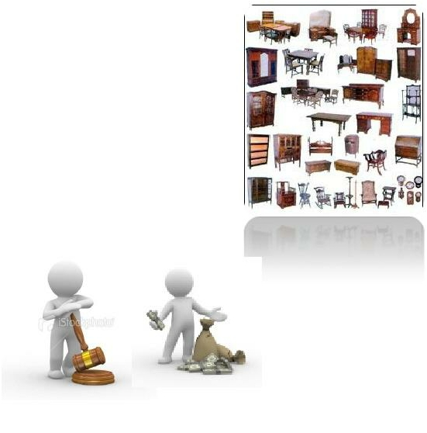

Traditional Auctions
• Auctions are used to sell many things in addition to antiques and
art. All around the world there are auctions of commodities such as
tobacco, fish, cattle, racehorses, and just about anything else
where there's a market of multiple people interested in buying the
same thing. That's the key to an auction - a bunch of people who
are interested in buying the same object, and taking turns offering
bids on the object. The right to buy that object will go to the highest
bidder.
• USERS INVOLVED in traditional auction
– SELLERS
– BUYERS
– AUCTIONEER
Buyer
Auctioneer
Seller
4

Slide 5

Auction house working steps :-
• For weeks or more before an auction, the auction house assembles merchandise, that is,
items that will be sold at the next auction. These items, sometimes called "merch," come
from a variety of sources.
•
As items come into the auction house, there's a lot of
work to be done. Items must be assigned numbers,
called "lot numbers. " Lists, and perhaps a catalog,
must be prepared recording the items that will be
sold, giving brief descriptions of each item (hopefully
these descriptions are accurate) by lot number.
Generally this list will also indicate the order in which the lots will be sold.
• As merchandise is prepared for the auction, it is often put into an area near the stage or
podium from which it will actually be sold when auction time rolls around. Most auction
houses have viewing times before the actual start of the auction. This is when you can
inspect the items that will be sold. It is very important that you do this. In fact, inspecting
items that are offered for sale is the first step in protecting yourself against bidding too much
for an item.
• Send invites to all the interested bidders/parties by using various methods like send mail
invitation via post or email, call personally, make multiple calls, publish ads in news papers,
radios, TV etc
• The steps listed are in general and may extend, feel free to contact us to discuss it in details.
5

Slide 6


Drawbacks of the traditional auction model
• The process is time consuming. No assurance of
good to be in good condition or quality and hence
physical inspection of good is essential.
• Date and time plays an important role. As they
operate for couple of hours only.
• Physical presence is needed for the Bidder and the
Auctioneer to conduct the auction.
The auction can be open or private, bidder needs to keep
a watch on the media for long as such events are not
daily thing.
The highest bidder always wins, keeping masses away
from getting the benefit of the auctions.
The complete process for the auctions to be organized by
the auctioneer and th auction houses is time conduming
and hene not flexible.
More focused towards the collectors who are ready to
pay extra or more then the market price.
Bounded to geographical regions.
6

Slide 7

Modern way to overcome drawbacks :-
• Online Auctions is the answer
– Companies from various industries
are moving to online auction
– Agents acting on behalf of Auction
houses / companies make use of
– Entrepreneurs
• Provided a global platform for
bidder by getting it to masses
• Any interested parties can put
their goods for auction
7
7

Slide 8


VIRTUAL AUCTIONS
8

Slide 9


Users Involved
• Bidder
– One who is keen on
buying products for a
relatively competitive
price by placing multiple
bids
• Auctioneer
– One who is responsible to
judge the auction or the
one who takes the
Buyer /
Bidder
Auctioneer/
Admin
Seller
decision of selecting a bid
• Auction
House/Admin/Seller
– Responsible to
provide/arrange an
opportunity for auctions
9
9

Slide 10

Features of Auctions
•
•
•
•
•
•
•
No time constraints
No geographical constraints.
Intensity of social interactions
Large number of bidders.
Large number of sellers
Network economies
Unique bid auction
Features of Auctions
…. ---.- .---.- ….
…. ---.- .---.-
…. ---.- .---.-
…. ---.- .---.-
…. ---.- .---.-
•
•
•
•
•
•
•
•
Highest Unique Bid
Lowest Unique Bid
Captures consumers' surplus
Auction as it deals for Selling of the goods online in a competitive market.
Hence e commerce is an important aspect of online auctions
In online auctions the payments are made through various option available online and offline.
Online payment option using Paypal, Authorize, Google Checkout, etc & majorly Credit Cards
The transactions are safe as it safeguard both the parties
10
10

Slide 11


Types of Auction
11

Slide 12

Primary types of Auction
• English auction
– ascending price auction.
• The auction ends when no participant is
willing to bid further, at which point the
highest bidder pays their bid
• Dutch auction
– open descending price auction
• In the traditional Dutch auction the
auctioneer begins with a high asking
price which is lowered until some
participant is willing to accept the
auctioneer's price.
• Sealed first-price auction
Secondary type of Auctions
All-pay auction
– is an auction in which all bidders must pay
their bids regardless of whether they win.
The highest bidder wins the item
– primarily of academic interest,
– or competitions such as a running race
Buyout auction
– any bidder can accept a fixed amount any
time during the auction, thereby
immediately ending the auction and winning
•
•
–
first-price sealed-bid auction
• In this type of auction all bidders
•
Combinatorial auction
simultaneously submit sealed bids so that
no bidder knows the bid of any other
participant. The highest bidder pays the
price they submitted.
• Vickrey auction
• - sealed-bid second-price auction.
• This is identical to the sealed first-price
auction except that the winning bidder
pays the second highest bid rather than
their own
• in practice Vickrey auctions are rarely
used
12
more than one item where bidders can
place bids on an "all-or-nothing" basis on
"packages" rather than just individual items
– e.g. :- A+B = $50, B+C= $30, A+C= $80
No-reserve auction
absolute auction
is an auction in which the item for sale will be
sold regardless of price. Bargain is done
directly between the seller and buyer More
Bidders more the selling price
12

Slide 13

Secondary type of Auctions
•
Reserve auction
– is an auction where the item for sale may not be sold if the final bid is not high enough
–
to satisfy the seller
– Seller reserves the right to sell for the winning amount
Reverse auction
– is a type of auction in which the role of the buyer and seller are reversed
– In a reverse auction, sellers compete to provide a good or service by offering progressively
lower quotes until no supplier is willing to make a lower bid
– Elance, GAF, Guru etc
Silent auction
– is a variant of an English auction where bids are written on a sheet of paper.
Top-Up Auction
– Bidders must pay the difference between their bid and the next lowest bid, whether they win or
not. Only the winning bidder does not have to pay the "top-up" fee, but does have to pay for
the item
– Not popular, though used in Charity events
Walrasian auction
•
•
•
•
– is an auction in which the auctioneer takes bids from both buyers and sellers in a market of multiple
goods.
– The auctioneer progressively either raises or drops the current proposed price depending on the bids of
both buyers and sellers, the auction concluding when supply and demand exactly balance
• * In an open auction participants may repeatedly bid and are aware of each other's previous bids.
•
* In a closed auction buyers and/or sellers submit sealed bids
13

Slide 14

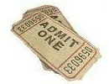
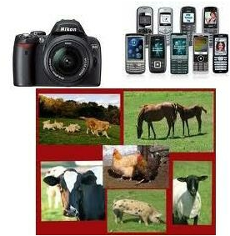
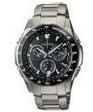

Auctions used by the
Industries using Auction industry
• Antique business
• Collectibles
– Stamps, Coins, etc
• Wine auction business
– Old & genuine wines
• Real property/Estate
– Residential
– Commercial
– Industrial
• Second-hand goods
– Anything that a user want to sale
•
•
•
•
•
Commodities
– Fishing
– Farming
– Any equipments in this industry
Livestock
– sheep, cattle, pigs and other livestock
are sold
Wool
Forced Legal Auctions by LEA
– Confiscated goods
Travel tickets
– Travel/Holiday Packages
– Promote travel
out in a garage sale
–
It can be performed by tie up with other
companies
–
Electronic items
–
–
Mobile phones, TV, Computers, Beauty
products, cameras, watch
House hold applicances
– Beauty products, clothes, merchandise
Projects
–
–
–
IT projects, Tenders for Development &
Manitenance
Construction, fitting, etc
………….. Contd
14
14

Slide 15

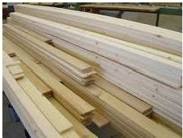

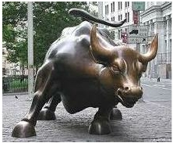

Industries using Auction
• Timber & Lumber auctions
• Debt auction
–
Debt
•
•
• Auto auctions
receivables accounts are auctioned
Loan accounts of individuals are sold at a price to other companies
–
–
• Stocks
–
Car new & Old
Bikes old and new
Auction Market
• A market in which buyers enter competitive bids and sellers enter
competitive offers at the same time. The price a stock is traded
represents the highest price that a buyer is willing to pay and the
lowest price that a seller is willing to sell at. Matching bids and
offers are then paired together and the orders are executed.
• The New York Stock Exchange (NYSE) is an example of an auction market.
•
For example , 4 buyers want to buy a share of XYZ and make the following bids:
$10.00, 10.02, 10.03 and $10.06. Conversely, there are 4 sellers that desire to sell XYZ
and they submitted offers to sell their shares at the following prices: $10.06, 10.09,
10.12 and $10.13. In this scenario, the individuals that made bids/offers for XYZ at
$10.06 will have their orders executed. All remaining orders will not immediately be
executed and the current price of XYZ will then be $10.06.
15
15

Slide 16
Leading Auction houses
• UK Auction Houses
– Bonhams
– Christie's
– Sotheby's.
• USA Auction Houses
Legal Difficulties
Not allowed in some countries
Stolen goods are sold online
–
–
–
–
–
–
–
–
–
Christies
Sotheby’s
Skinners – Bolton, Massachusetts
Doyle’s
Bonham and Butterfield’s Los Angles, California
Heritage Dallas, Texas
Susanina’s Auctions Chicago, Illinois
DuMouchelle Auction Galleries Detroit, Michigan
Kruse Auction Auburn, Indiana
16
16

Slide 17

Our Existence
• We have currently worked on many Online Auction Portals for US, UK &
Dubai Market etc
– UK Clients :- Plbid, Bidamin, Yourjobquoted,
– USA :- Bidstar, WeddingVending, Zohz, mypenny auctionbox, rodepbid
– Dubai :- Plbid
– Australia
• Service List
– South Africa
• FreelanceLife
17
17

Slide 18



Online Popular Auction sites
• Ebay the most popular online auction sites review per websiteshadow.com
Website Worth: $ 254,802,240 USD
Yearly Ads Revenue: $ 26,329,565 USD
Daily Page views: 586,752,936
Ebay bought bazee in 2005 for $ 518836
• Elance the most popular online reverse auction sites review per
websiteshadow.com
Website Worth: $ 18,195,408 ( € 12,362,179)
Yearly Ads Revenue: $ 1,880,192 ( € 1,277,425)
Daily Page views: 29,849,754
• Swoopo the most popular online reverse auction sites review per
websiteshadow.com
Website Worth: $ 124,962 ( € 84,901)
Yearly Ads Revenue: $ 105,410 ( € 71,617)
Daily Page views: 212,026
* The above are only few popular sites
18

Slide 19
More Online Popular Auction sites
• Allegro
• Apex auctions
• Bidorbuy
• Bidtopia
• The Debt Exchange
• eBay
• eBid
• GunBroker.com
• Heritage Auction
Galleries
• Hobby Markets Online
• Lixtor
• MercadoLibre.com
• Overstock.com
• Oztion
• Prosper.com
• SalvageSale, Inc.
• Swoopo
• TradeMe
• Tradus (former QXL)
• uBid
19

Slide 20

Major Plyaer’s in Penny Auctions
20

Slide 21

21

